Slide 1
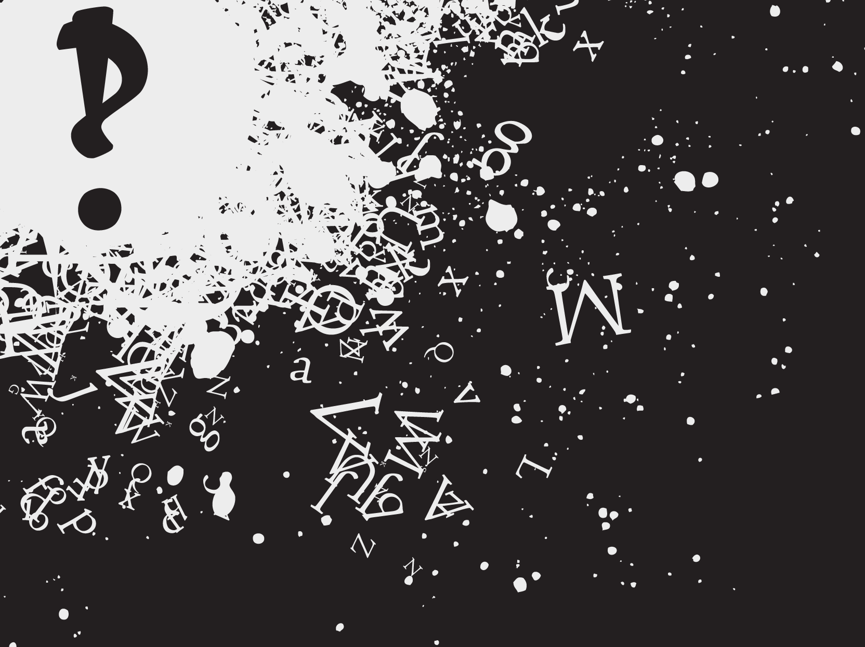
Notes:
<Tyler> Ahoy, nice to meet you. We’re Interrobang Interactive, and we’ve developed what we dare say is the best implementation of Hunt the Wumpus ever created.
Pause, 2 seconds
*****

Slide 2
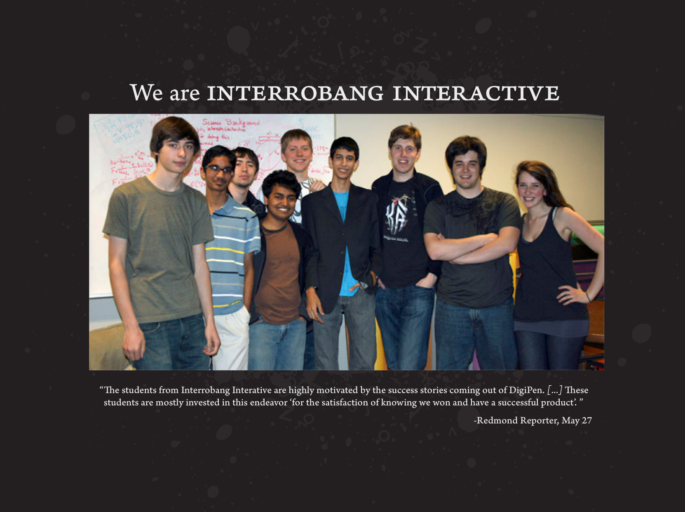

Slide 3
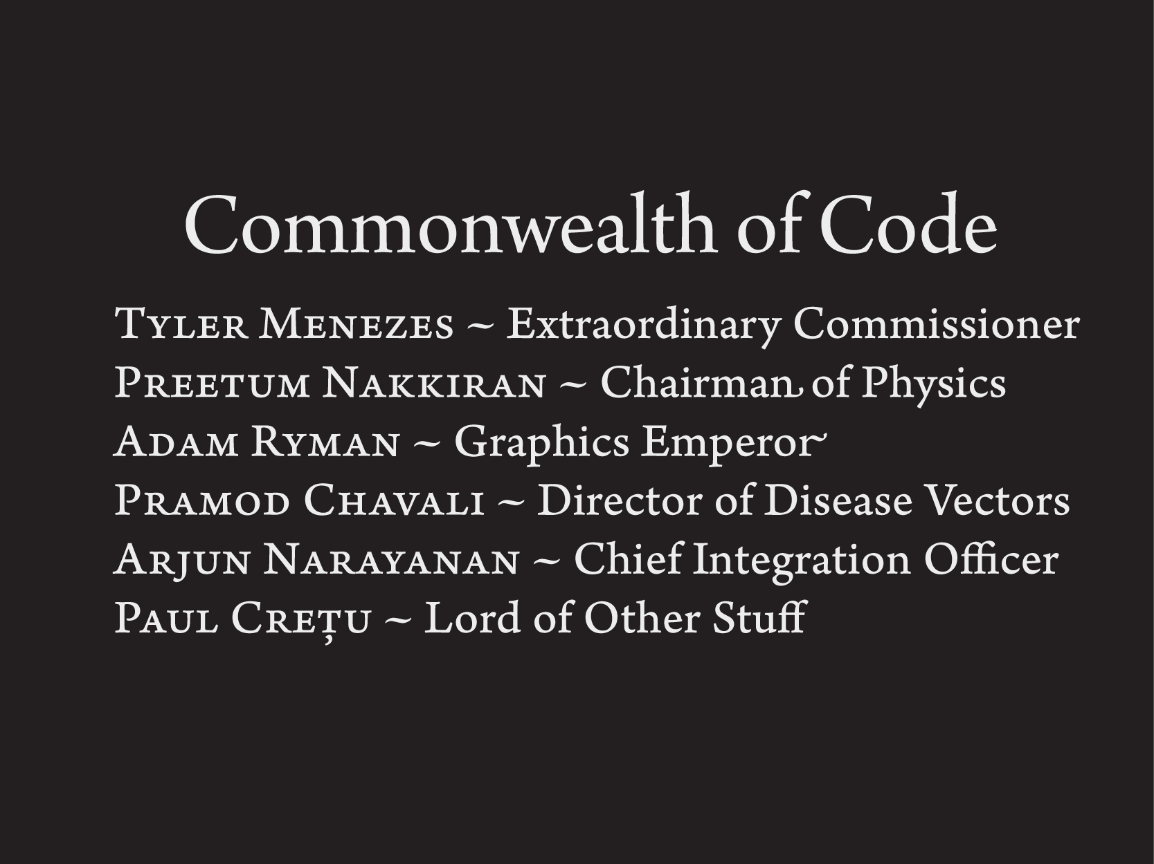
Notes:
<Tyler> Our team was split up into two groups which were responsible for both the artistic and code contributions to the final product.
Pause, 2 seconds
<Tyler> I’m Tyler, and I’m the Extraordinary Commissioner
<Preetum> I’m Preetum and I’m the Chairman of Physics
<Adam> I’m Adam and I’m the Graphics Emperor
<Jamocha> I’m Jamocha and I’m the Director of Disease Vectors
<Arjun> I’m Arjun and I’m the Chief Integration Officer
<Paul> I’m Paul and I’m the Lord of Other Stuff
Pause, 1 second
<Tyler> All the members will be describing their individual contributions in a moment, but first I’d like to explain the way our engine works.
Pause, 1 second
*****

Slide 4
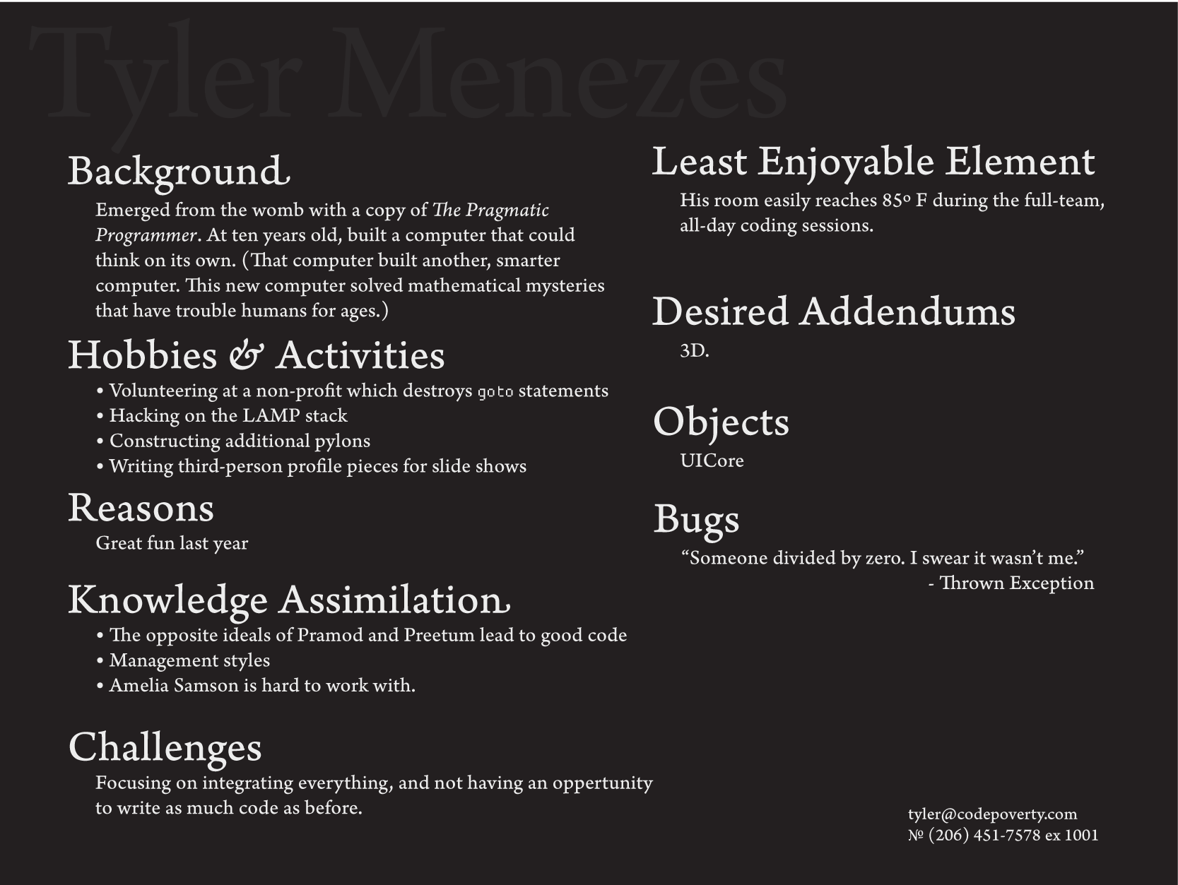

Slide 5
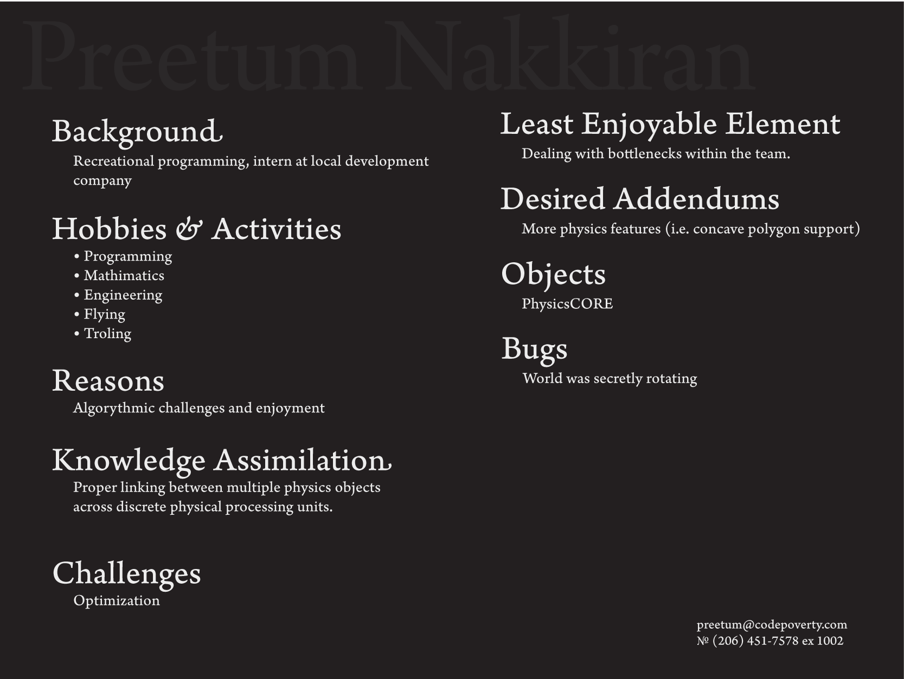

Slide 6
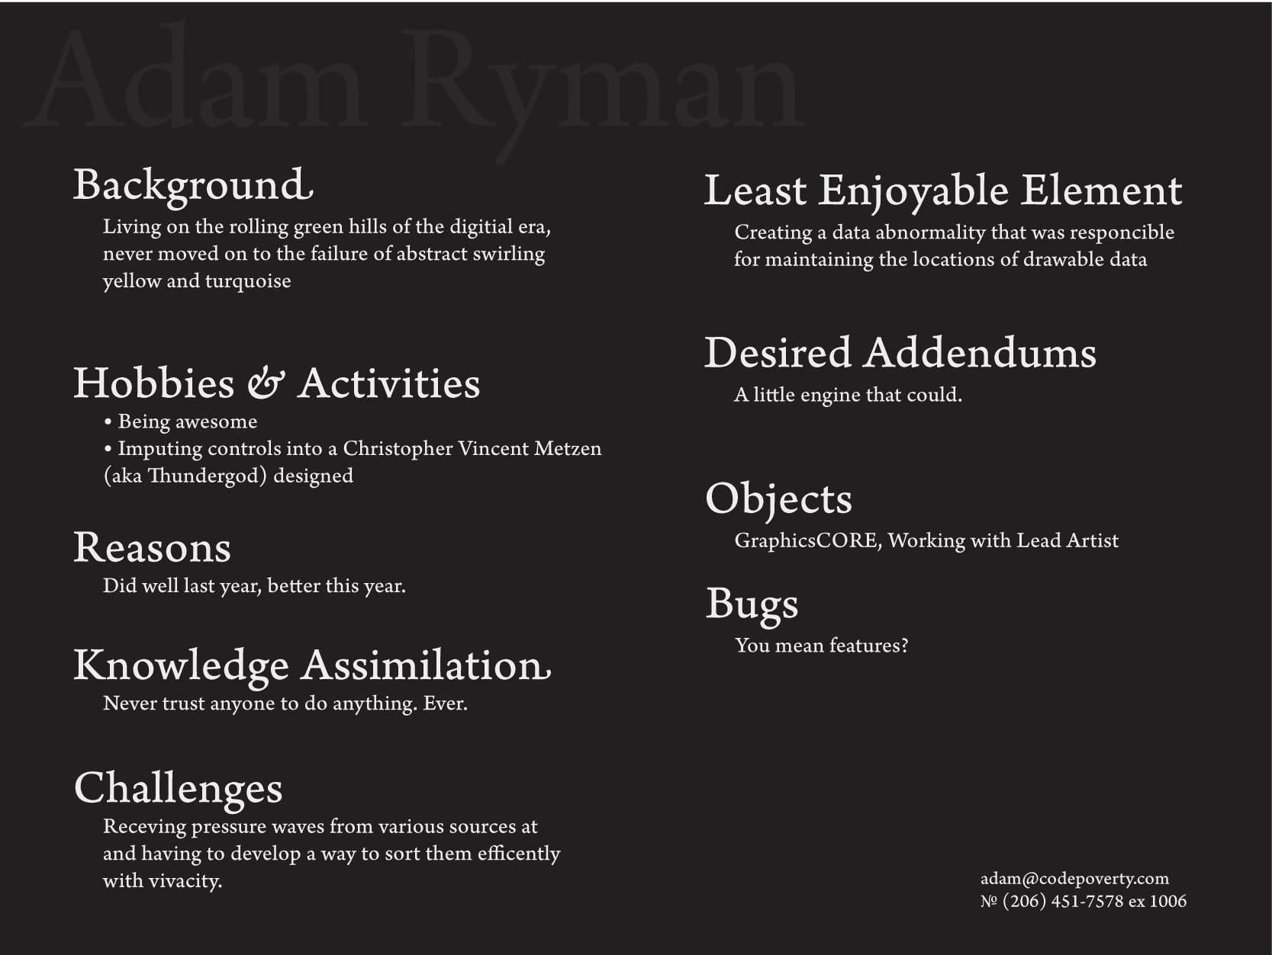

Slide 7
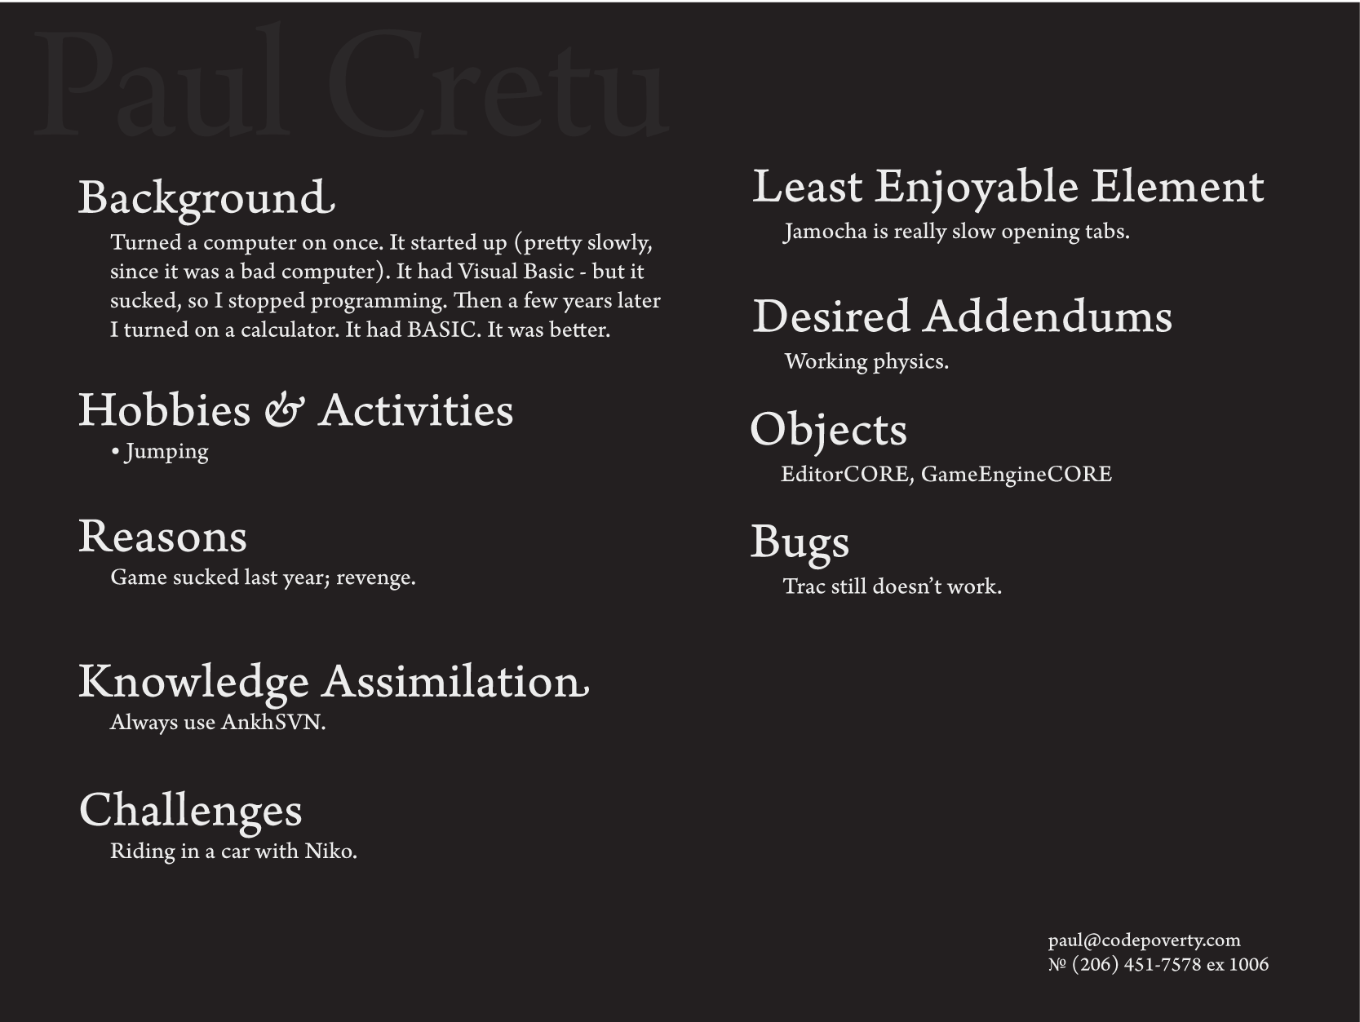

Slide 8
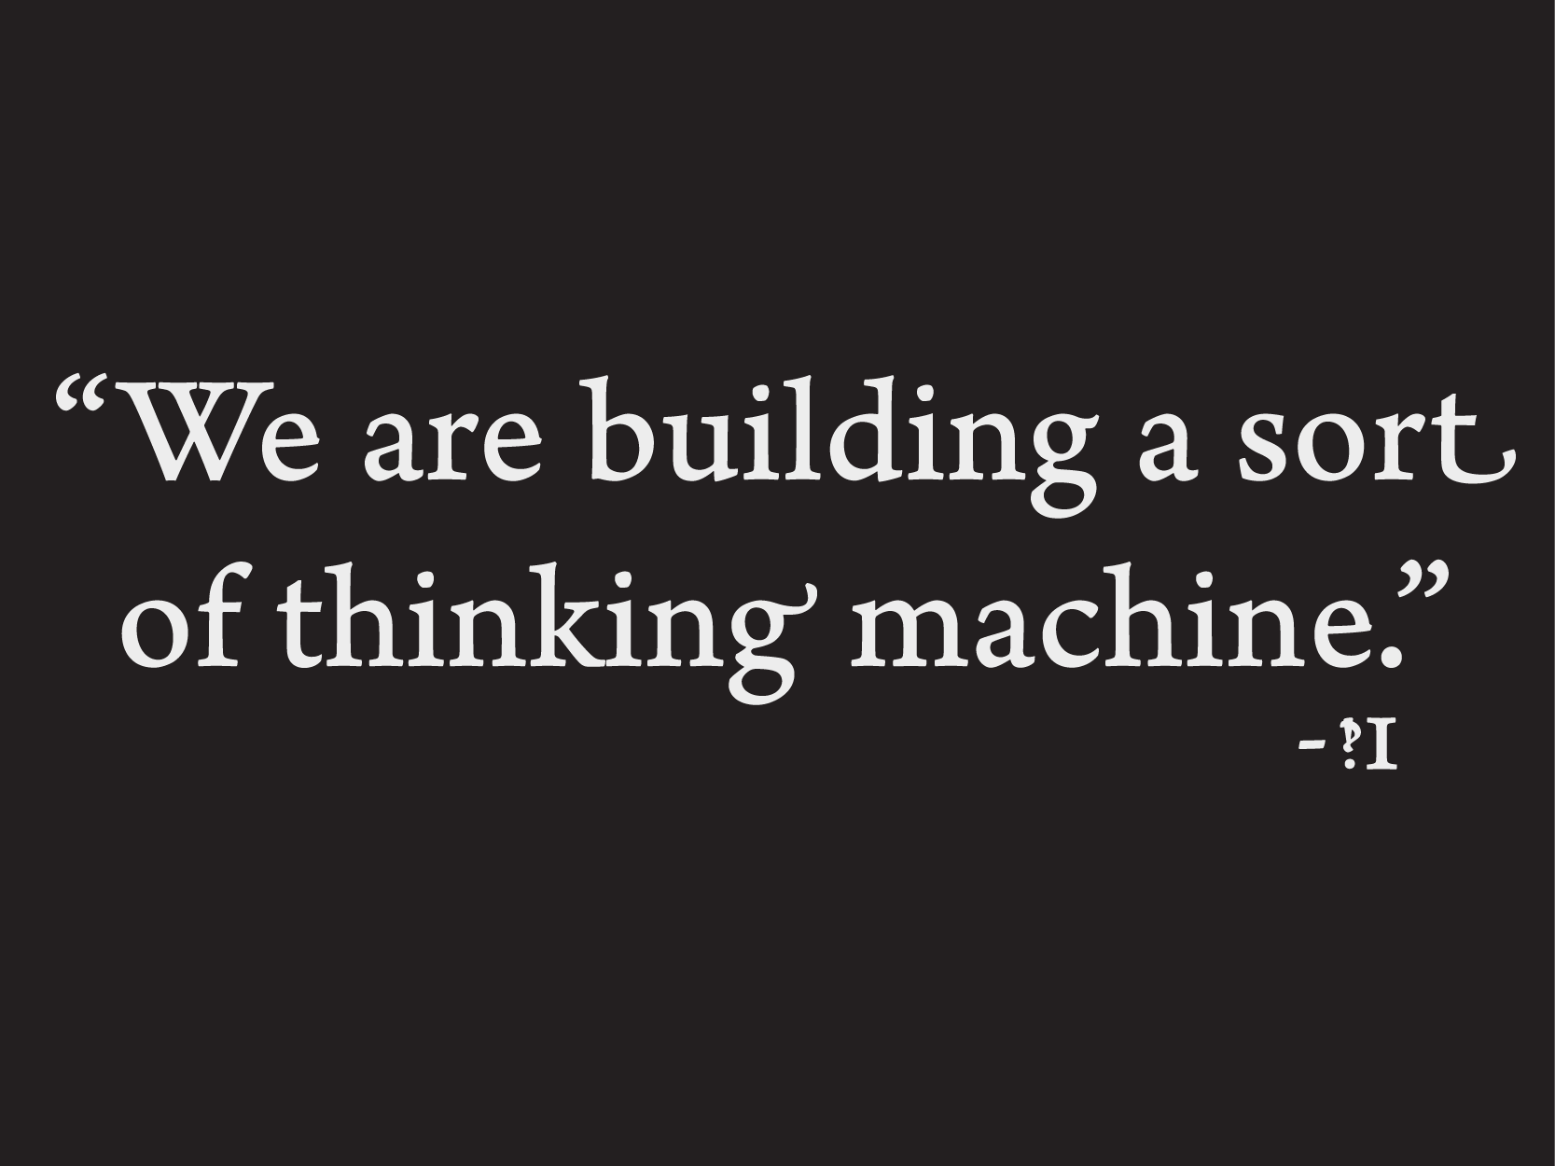
Notes:
<Tyler> When we first started out, we weren’t interested in building an implementation of Wumpus. That would come to be the trivial part. We were more interested in the abstract logic of games.
Pause, 1 second
<Tyler> We did not build a game so much as we built, pause, .5 seconds, a sort of, pause, .5 seconds, thinking machine.
Pause, 2 seconds
*****

Slide 9
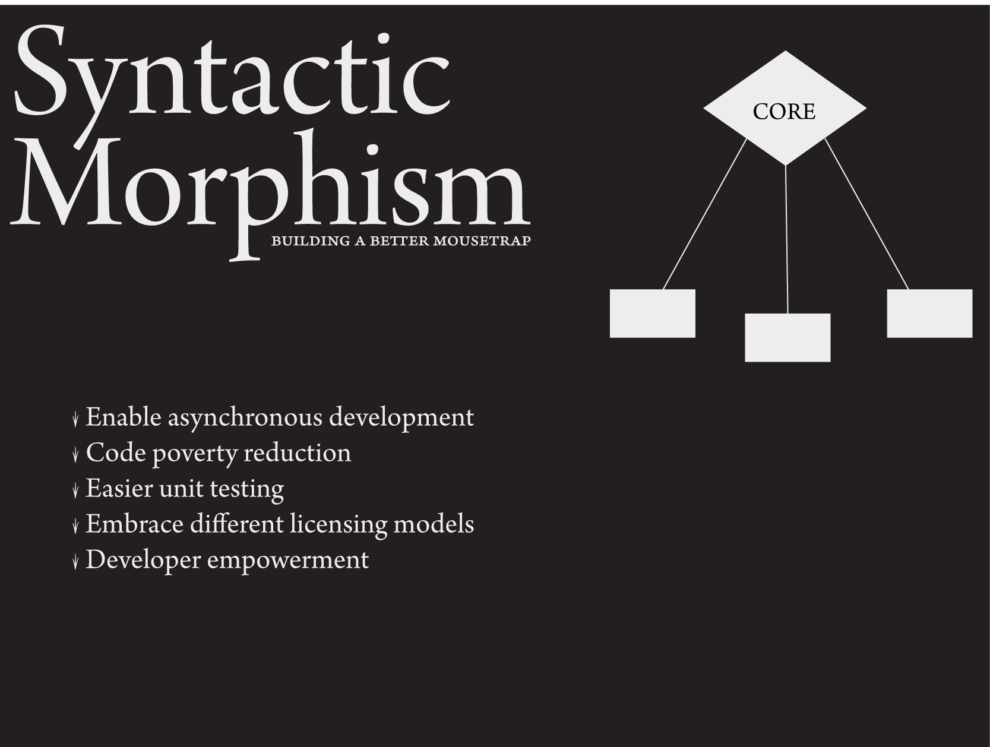
Notes:
<Tyler> Going back to when we first set out to make a game, we were looking for something which would fulfill the wide variety of requirements which we would need. Our ideas were ambitious, so our code would need to be testable by multiple developers with different code states at the same time.
Pause, 1 second
<Tyler> We had a short deadline, so we wanted to make sure everyone had something to work on at all times, and that no one was blocked.
Pause, 1 second
<Tyler> We wanted to test our code extensively before the expo.
Pause, 1 second
<Tyler> We were thinking of releasing this project and were unsure of the licensing, so we wanted our code to support third-party developers without needing the source.
Pause, 1 second
<Tyler> And finally, we wanted the developers to feel good while they were working.

Slide 10
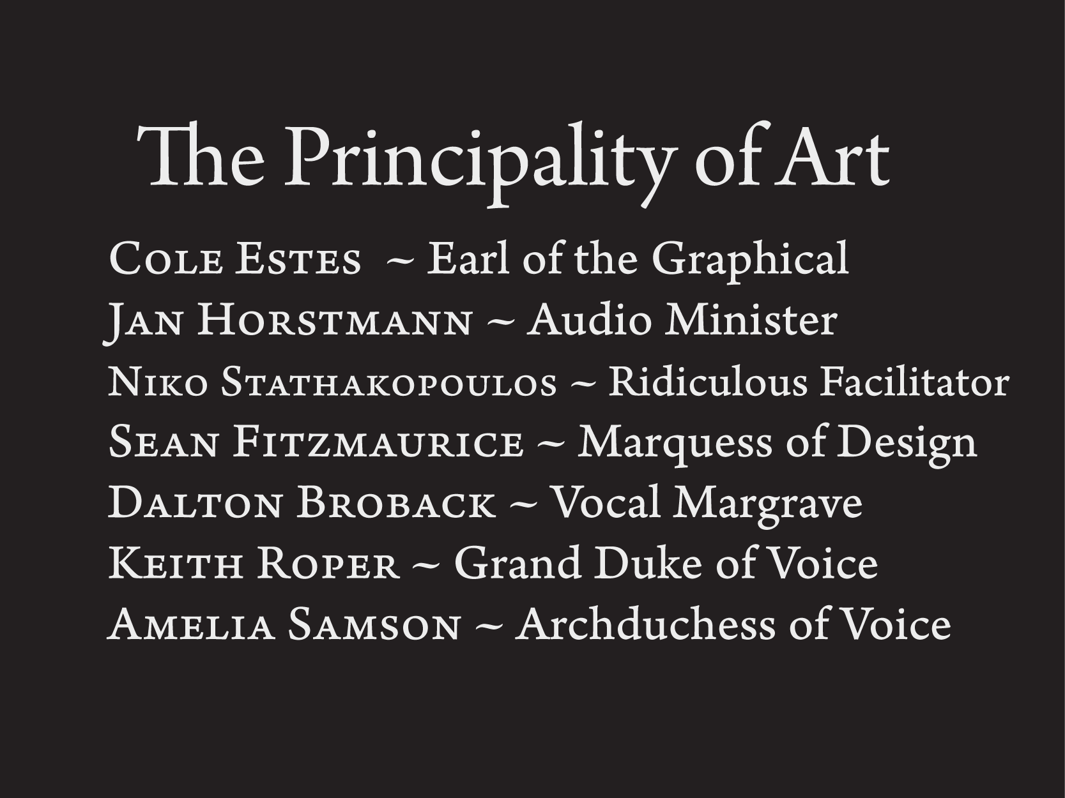

Slide 11
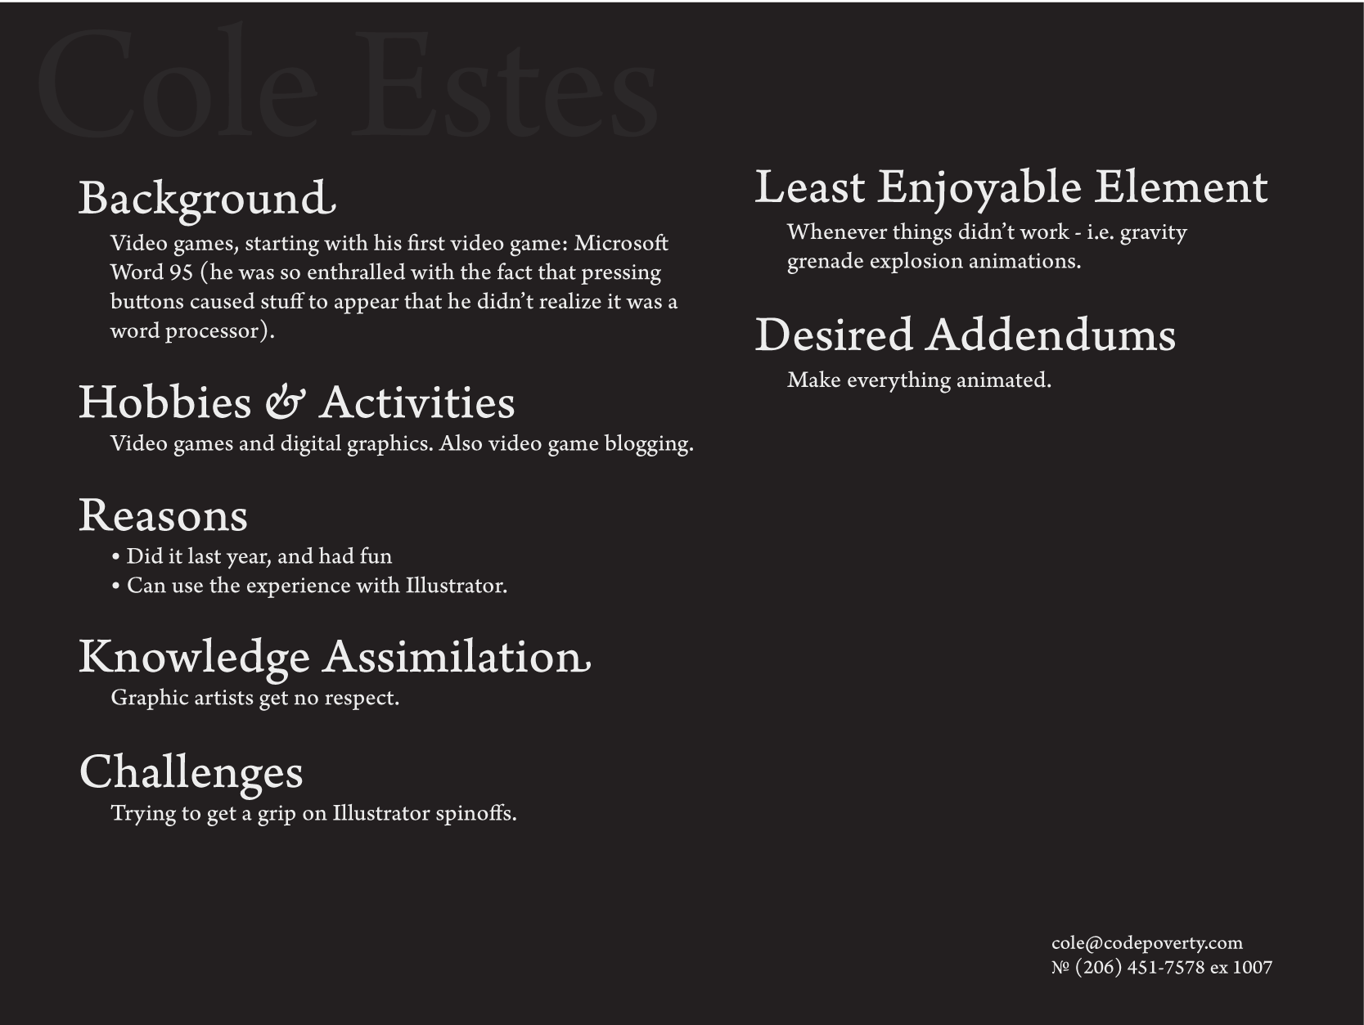

Slide 12
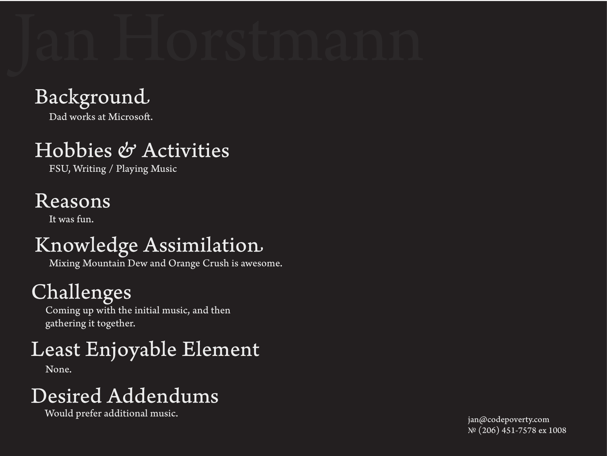

Slide 13
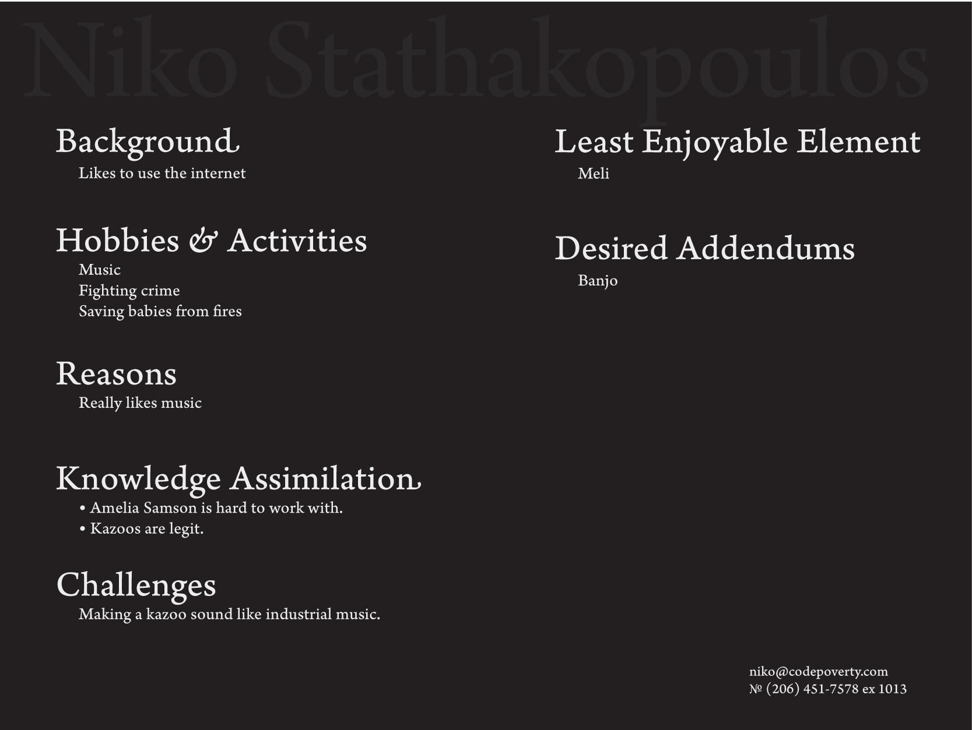

Slide 14
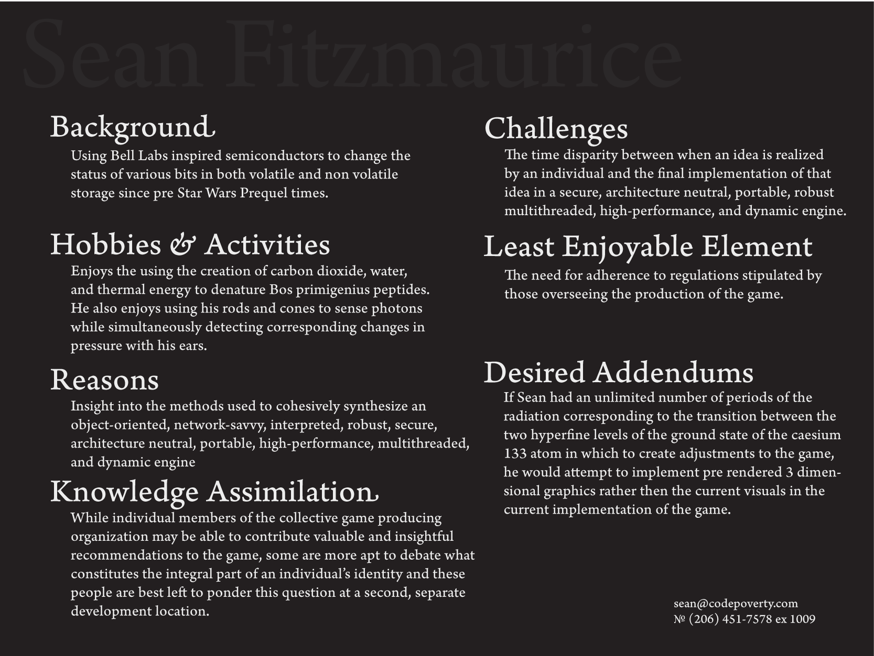

Slide 15
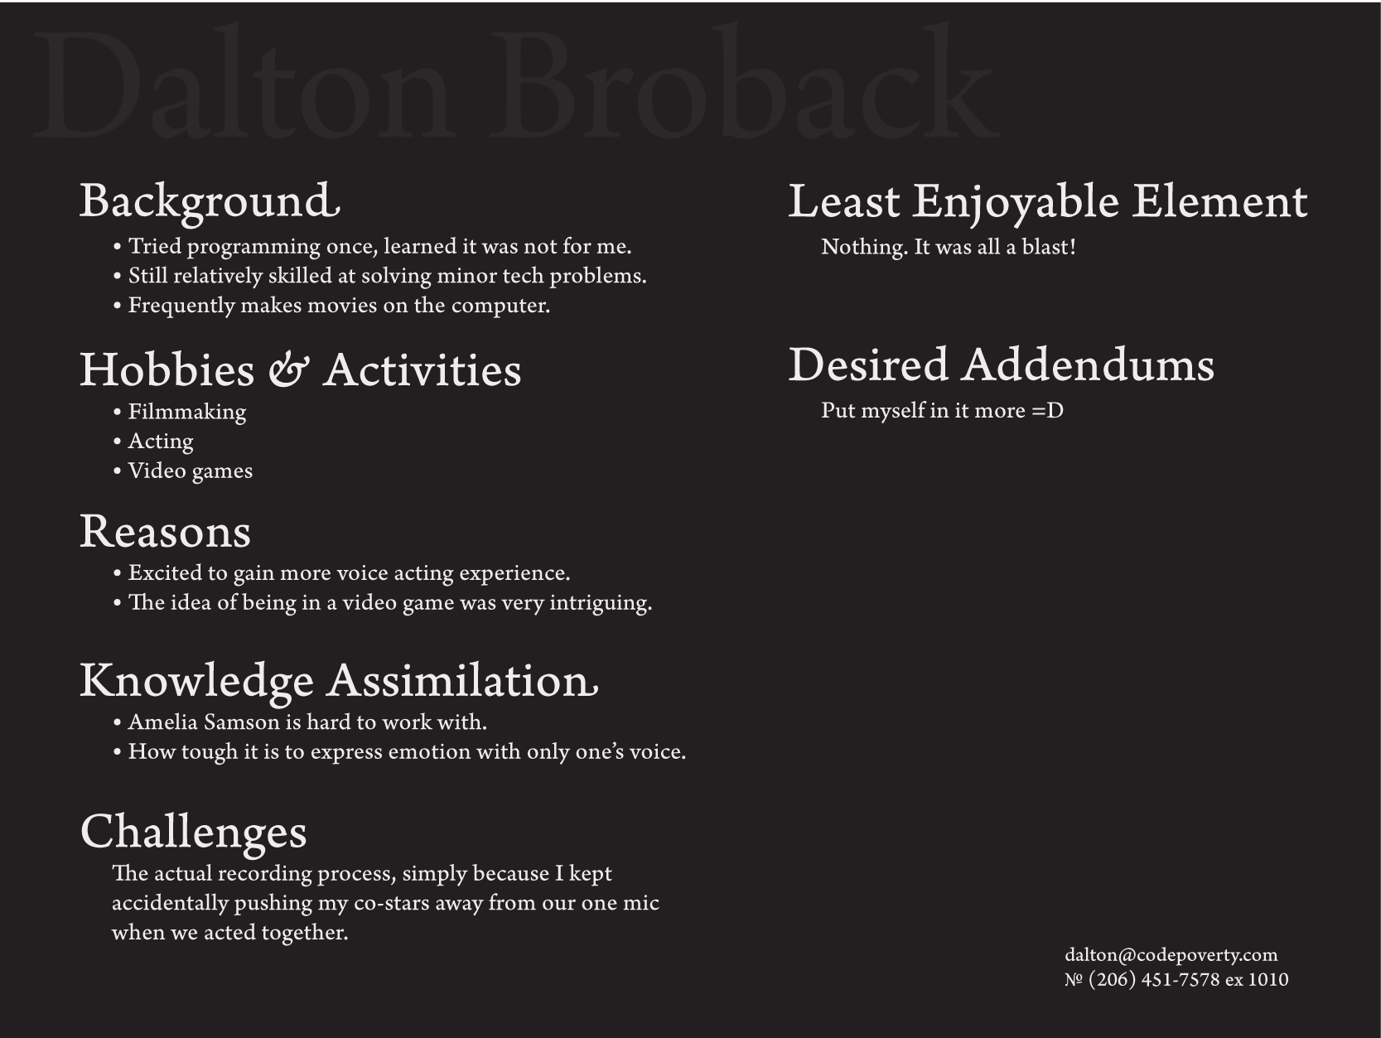

Slide 16
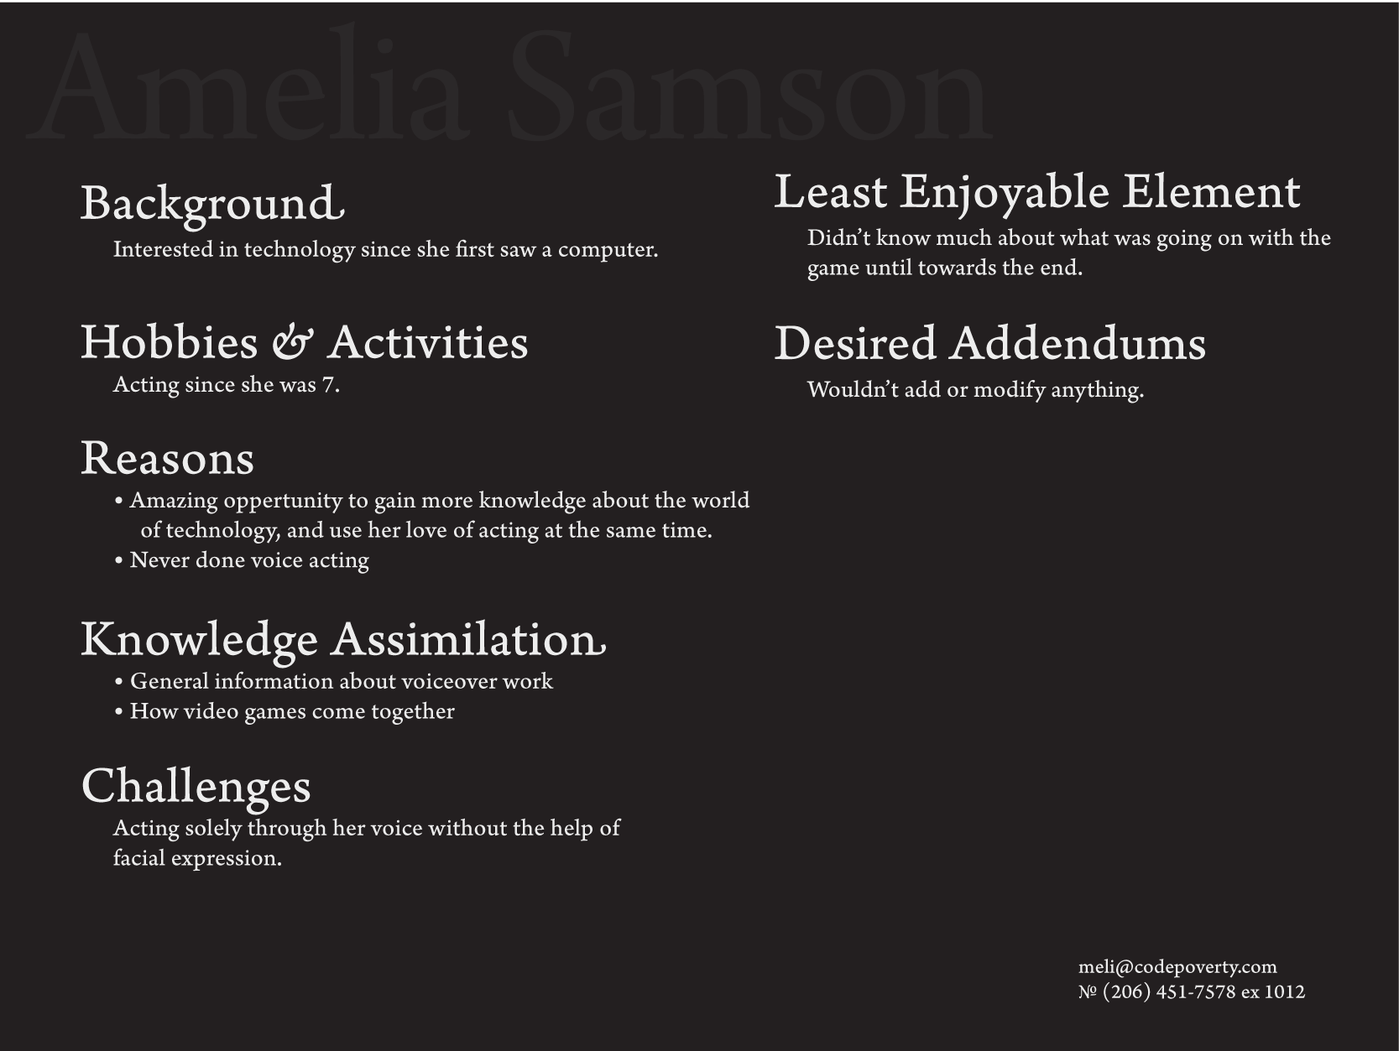

Slide 17
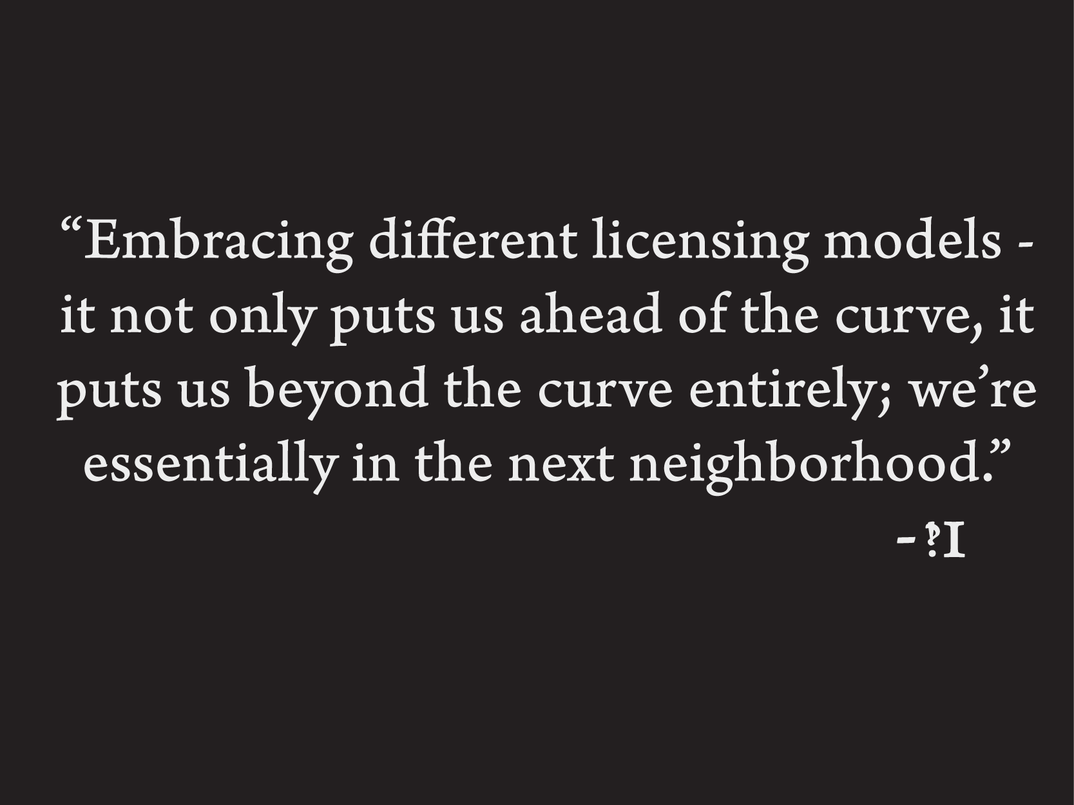

Slide 18
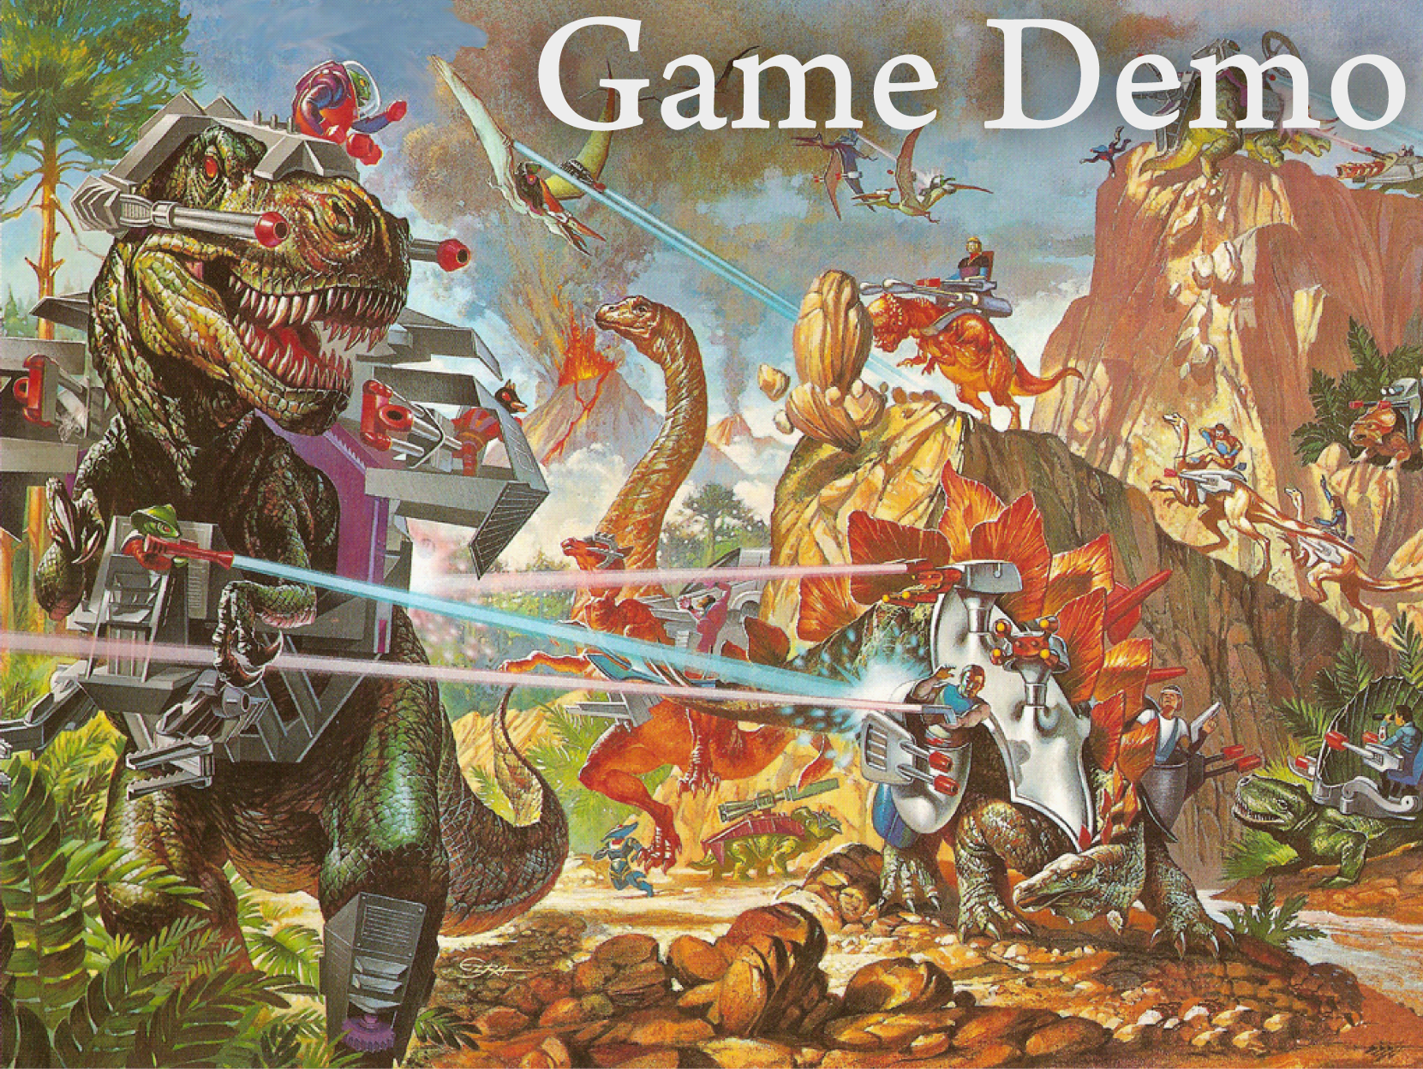

Slide 19


